Slide 1
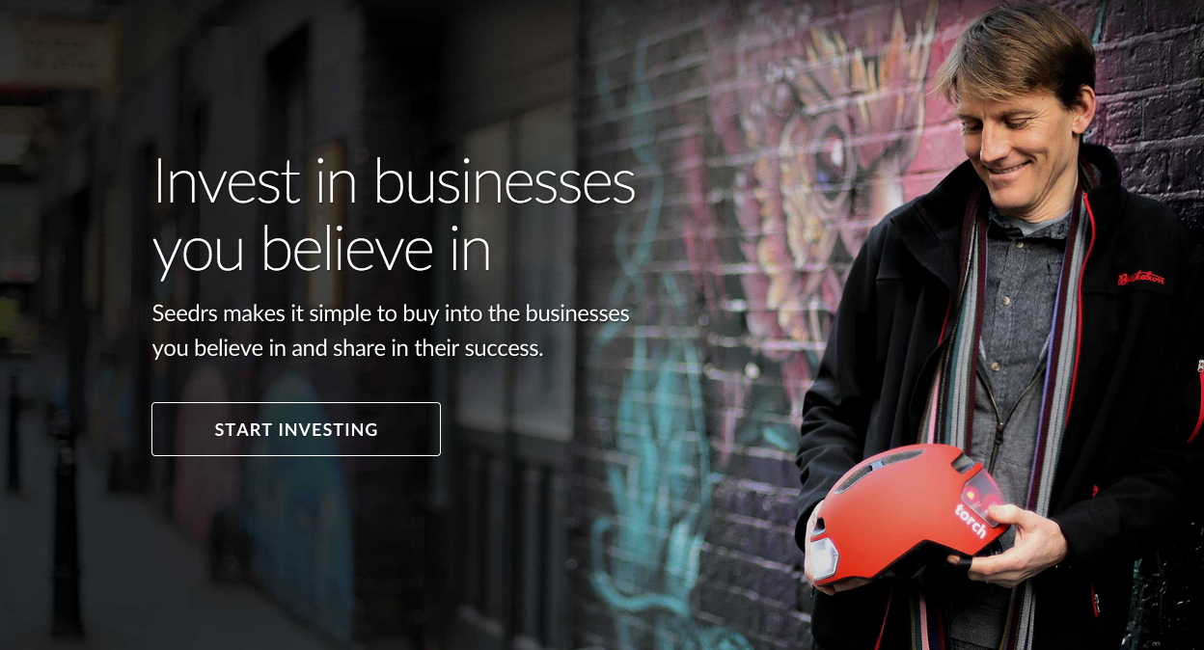

Karen Kerrigan | Legal & Financial Director | @KarenSeedrs

Slide 2
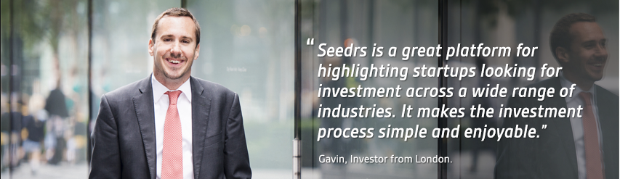
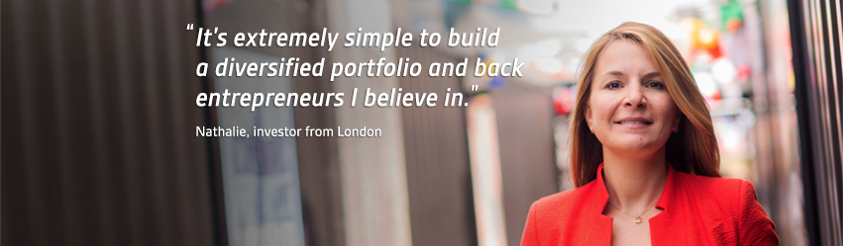
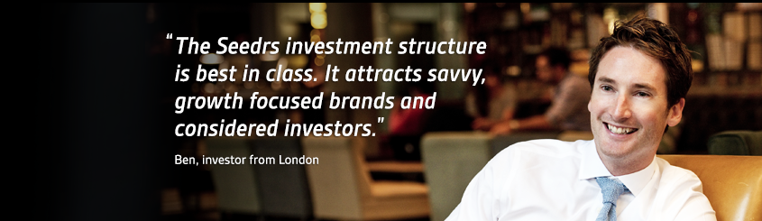
Intro to Seedrs
We let investors invest as little or as much as they like (from £/€10 up) in businesses they believe in
We let entrepreneurs raise seed and early-stage capital from friends, family, angels, institutions, customers and more
We do everything through a digitised, standardised, simple online process
We’re based in London and Lisbon, and we’re open to investors and entrepreneurs across Europe

Slide 3
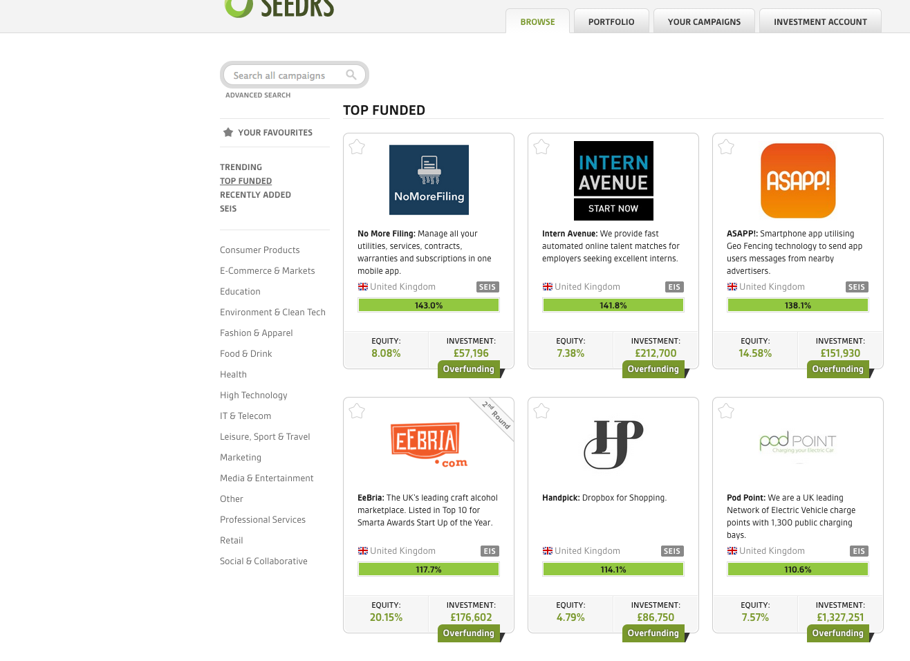
The Beginnings
Incorporated in 2009
Received approval from the then-FSA in 2012
First equity crowdfunding platform to receive regulatory approval
Broad rage of permissions
Opened up asset class
Pioneered process

Slide 4
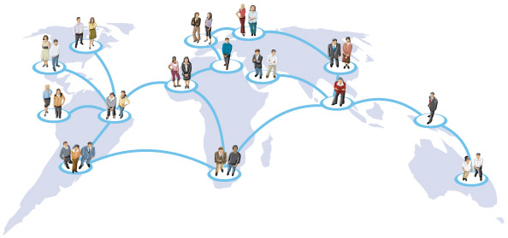
Investor Protection
We act as nominee
We are the sole legal shareholder
  We cast votes, grant consents and take other shareholder actions
  Professional investor protections
For growth-focused companies – this is really important
  Clean cap table
  Aligned interests

Slide 5

Challenges
UK regulation
Europe / international reach
Fraud
Failing consumers
Competition / rogues

Slide 6
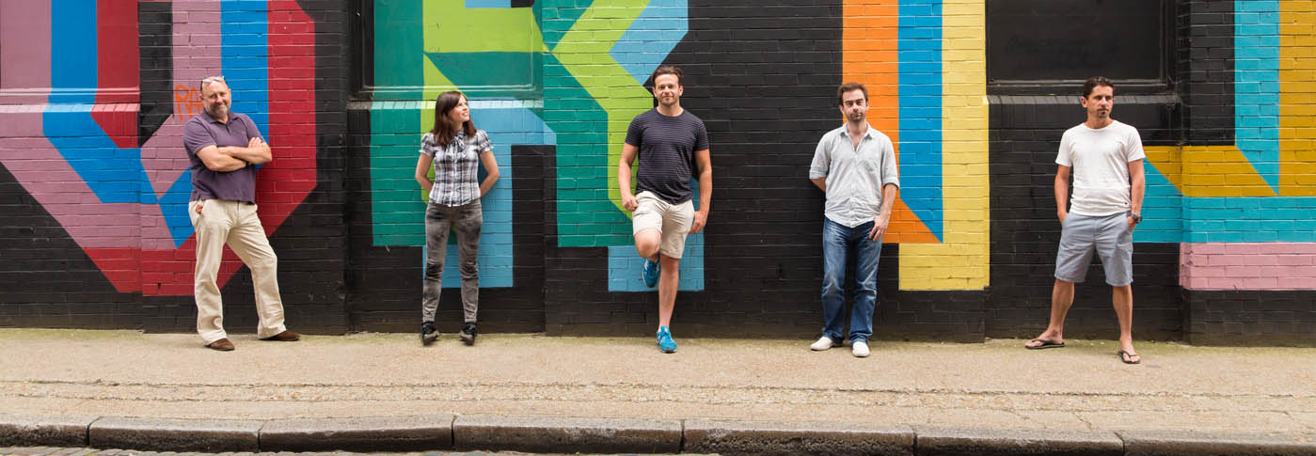
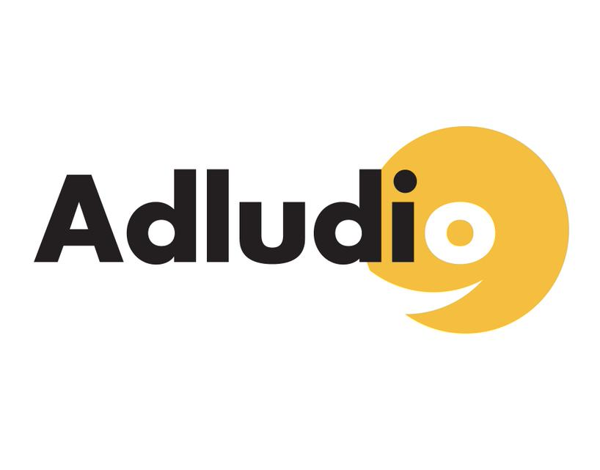
Adludio
London-based ad tech startup that initially raised £60,000
in July 2012 from 70 investors
Returned to raise over £500K from over 400 investors in July 2014

Slide 7
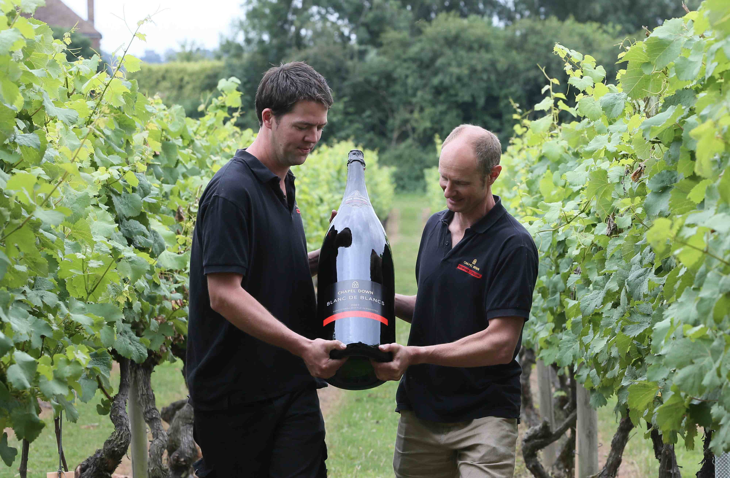

Chapel Down
Publicly-traded company, and leading UK winemaker
and craft brewer
Raised £3.9M, from over 1,450 investors in less than 3 weeks

Slide 8
Questions?
Seedrs is authorised and regulated by the Financial Conduct Authority. Investing involves risks, including loss of capital, illiquidity, lack of dividends and dilutions and should only be done as part of a diversified portfolio. Seedrs is targeted solely at investors who are sufficiently sophisticated to understand these risks and make their own investment decisions.
Karen Kerrigan | Legal & Financial Director | @KarenSeedrs

